Slide 1


Approximate Computing For Image Processing
Review-2
AY 2025-26
Capstone Project – Introduction (PROJ2999)
GITAM (Deemed-to-be) University
Department of Electrical Electronics and Communication Engineering
Project Team:
Akhila
Aishwarya KV
Gadiputi Vinay Vardhan
Project Mentor:
Shatadal Chatterjee
Project In-charge:
Shatadal Chatterjee
www.gitam.edu

Slide 2
Objective and Goals
Objective
To design a 3×3 convolution architecture for image processing using approximate computing techniques.
To reduce power consumption and hardware complexity by using approximate adders and multipliers.
To achieve real-time image processing performance suitable for embedded and low-power devices.
To evaluate image quality (PSNR, MSE) when using approximate arithmetic.
To compare exact vs approximate convolution in terms of speed, area, delay, and power.
Goals
• Implement a working 3×3 convolution module using approximate arithmetic.
• Reduce power usage by 40–60% compared to exact convolution.
• Maintain acceptable image quality for human perception.
• Optimize the design for FPGA/ASIC deployment.

Slide 3
Project Plan (Clearly mention milestone for objectives under each reviews)
First, we start by understanding what exact 3×3 image convolution is and how approximate convolution is different. We also study why approximate computing saves power and where it is used.
Next, we design and implement the exact 3×3 convolution using normal adders and multipliers. This gives us a clear “baseline” to compare against later.
Then, we choose the right approximate adders and multipliers such as LOA, ETA, or truncated multipliers that can reduce power and hardware usage. This step helps us prepare the approximate design.
After that, we implement the approximate 3×3 convolution, replacing the exact arithmetic units with approximate ones. We then test our design to see how much power is saved and how much image quality changes.
In the next step, we compare the outputs of exact and approximate convolution. We check differences in image quality (PSNR, MSE) and also compare delay, area, and power between both designs.
Finally, we combine all our results, prepare charts and tables, and complete the final project report and presentation by explaining which design is better and why.

Slide 4
Literature Survey
Key Publications
Paper 1:
Title: Low Power and Single Multiplier Design for 2D Convolutions
Publisher: IEEE
Published: 2021 (ICCCIS)
Main Idea: Single-multiplier 2D convolution for low-power hardware.
✔ Proposes a hardware-efficient 2D convolution design using only one multiplier, reducing power and silicon area.
✔ Uses shift-add and reuse techniques to compute convolution kernels with minimal hardware.
✔ Shows significant reduction in power consumption, making it suitable for embedded image systems.
✔ Relevant because your project also targets low-power 3×3 convolution
Paper 2:
Title: Construction of Sampling System for Electric Power Materials Using CNN
Publisher: IEEE
Published: 2023 (Smart Energy Systems Conf.)
Main Idea: CNN-based image enhancement and recognition for accurate sampling.
✔ Uses Convolutional Neural Networks to improve clarity, contrast, and feature visibility of images.
✔ Introduces a custom image enhancement process to handle low-light or over-exposed images.
✔ Achieves high accuracy (94.85% recall) in identifying objects in complex scenes.
✔ Relevant because it demonstrates how convolution operations improve image quality in real systems.

Slide 5
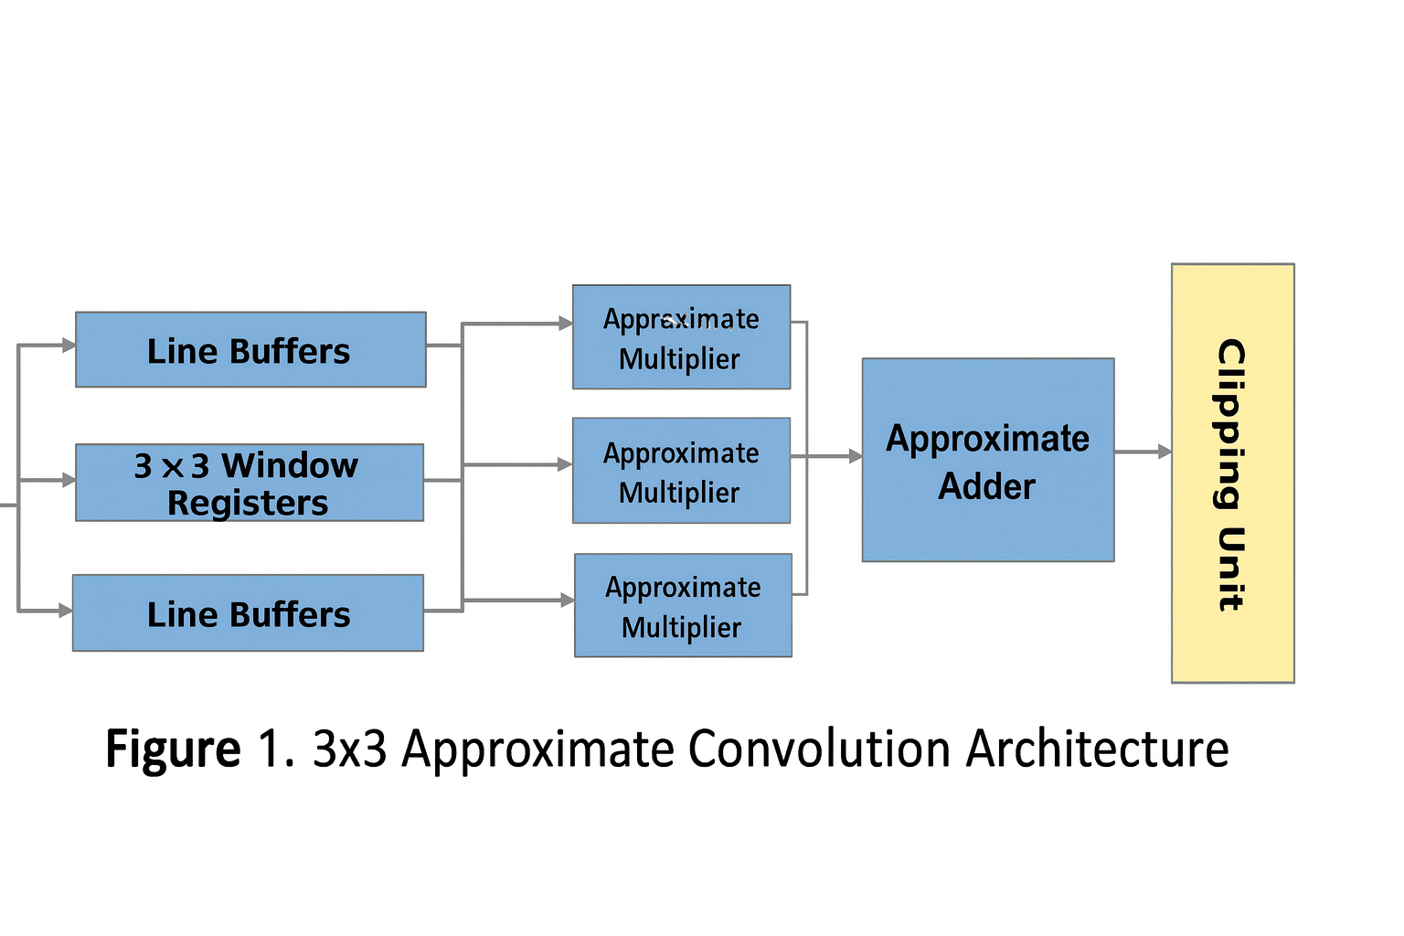
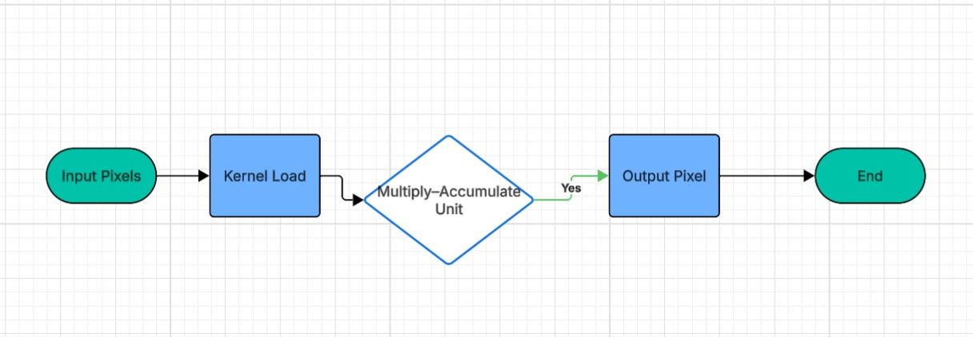
Architecture
Structural Diagram
Behaviour Diagram

Slide 6
Use Cases & Testing
Use Cases
1. Edge Detection
Approximate 3×3 convolution can be used for Sobel, Prewitt, and Laplacian filters.
Useful in surveillance cameras, robotics vision, and obstacle detection.
2. Image Smoothing & Noise Removal
Gaussian and average filtering using approximate arithmetic reduces power.
Suitable for mobile devices and IoT cameras.
3. Real-Time Video Processing
Low-power convolution enables real-time filtering in drones, robots, and embedded processors.
4. CNN Preprocessing
Convolution layer approximation can speed up computations in lightweight CNN models.
Test Cases
RTL Simulation Test:
Verify convolution output for sample pixel inputs in waveform.
3×3 Window Generation Test:
Check correct shifting of pixels through line buffers and window registers.
Kernel Operation Test:
Validate multiply-accumulate (MAC) operations for 3×3 kernel values.
Approx vs Exact Output Test:
Compare approximate results with exact convolution in Vivado simulation.
Clipping & Output Range Test:
Ensure final output pixel remains within 0–255 after accumulation.

Slide 7
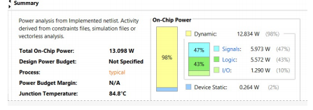
Implementation and Results – Iteration 1
Iteration 1 : Results
1. Implementation
1. Implementation
Implemented exact 3×3 convolution using full-precision multipliers and adders.
Line buffers and 3×3 window generator verified through RTL simulation in Vivado.
Tested with grayscale image pixels and common kernels (blur, edge, sharpen).
2. Power Analysis Result (Iteration 1)
(Exact Convolution – Baseline Design)
Key Observations from Power Report
Total On-Chip Power: 13.098 W
Dynamic Power: 12.834 W (≈ 98%)
Static Power: 0.264 W
Power Breakdown:
Signals: 5.973 W (47%)
Logic: 5.272 W (43%)
I/O: 1.289 W (10%)
3. Result Summary
Exact convolution works correctly and provides baseline accuracy.
High dynamic power consumption shows the need for approximate arithmetic in next iteration.
These results form the comparison point for Iteration 2 (Approximate Design).

Slide 8
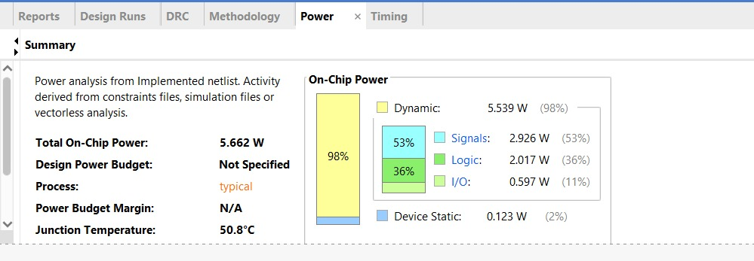
Implementation and Results – Iteration 2
1. Implementation: Approximate Convolution (Optimized Design)
Design Goal: Reduce the high power consumption observed in Iteration 1 (Exact Design) by implementing approximate arithmetic.
Methodology: Replaced the full-precision multipliers and adders with approximate arithmetic units (e.g., truncated or inexact multipliers) to reduce switching activity and complexity.
Functionality: Maintained the core functionality of the 3x3 window generator and preserved the image processing features (blur, sharpen, edge detection).
Validation: Results validated against the use cases and test cases defined in Slide 6 to measure the accuracy trade-off against power savings.
2. Power Analysis Result (Iteration 2)
The implemented Approximate Convolution netlist achieved significant power and thermal improvements:
Total On-Chip Power: 5.662 W
Junction Temperature: 50.8 ∘C
Dynamic Power Breakdown Iteration 1 (Exact) Iteration 2 (Approximate) Reduction
Total On-Chip Power 13.098 W 5.662 W 57%
Logic Power 5.272 W (43%) 2.017 W (36%) 3.255 W
Signals Power 5.973 W (47%) 2.926 W (53%) 3.047 W

Slide 9
Conclusion & Future Work
Summary and Conclusion
In this project, a 3×3 image convolution module was designed, implemented, and tested using Verilog on the Vivado tool. The main objective was to perform edge detection and feature extraction by applying a 3×3 kernel to input pixel data. The system architecture included input buffering, line memory implementation, sliding-window generation, and a convolution MAC (Multiply–Accumulate) unit.
Simulation results verified that the design correctly processes pixel values and produces the expected convolved output. Hardware synthesis reports confirmed that the design meets timing requirements and operates efficiently on the selected FPGA device. Overall, the project successfully demonstrates a working hardware model for real-time image filtering applications.
Future Work
Implement Additional Filters: Extend the design to support multiple kernels such as sharpening, Gaussian blur, and Sobel filters.
Add Dynamic Kernel Loading: Allow users to modify or load convolution kernels at runtime instead of using fixed coefficients.
Pipeline Optimization: Improve speed by introducing parallel MAC units and deeper pipelining for higher throughput.
AXI Interface Integration: Add AXI-stream or AXI4 memory-mapped interface to connect with real-time camera modules or processors.
Hardware Deployment: Test the design on an actual FPGA development board to evaluate real-time performance with live image data.

Slide 10
THANK YOU
Have a Great Day !

